Slide 1
IT 305
Computer Networks
Cellular Fundamentals-II

Slide 2
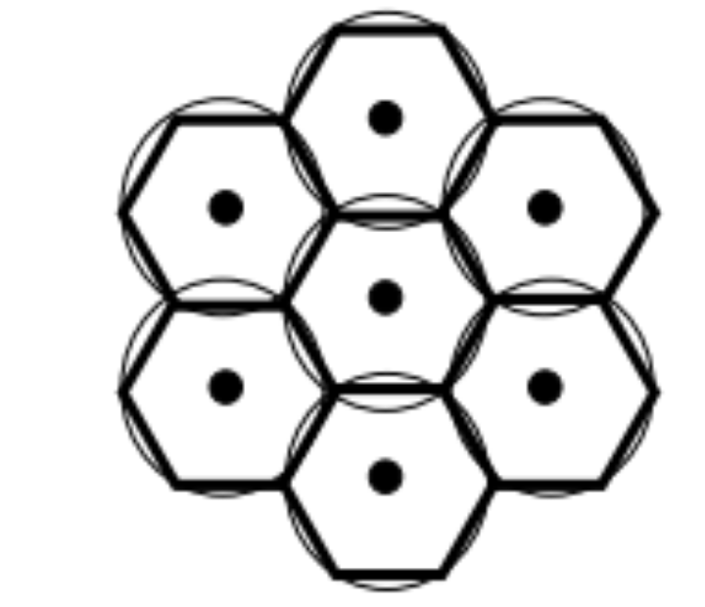
“Cell”ular Structure
Why hexagonal shape?
Close approximation to the circular pattern.
Eliminates the gaps between the adjacent circles,
  increasing the effective transmission

Slide 3
Properties of Cell structure
Typical Cell sizes
  Cites → few hundred meters
  Semi urban →few tens of kilometers
Advantages of cell structures:
  capacity due to frequency reusage
  Tx power
Problems:
  interference with other cells

Slide 4
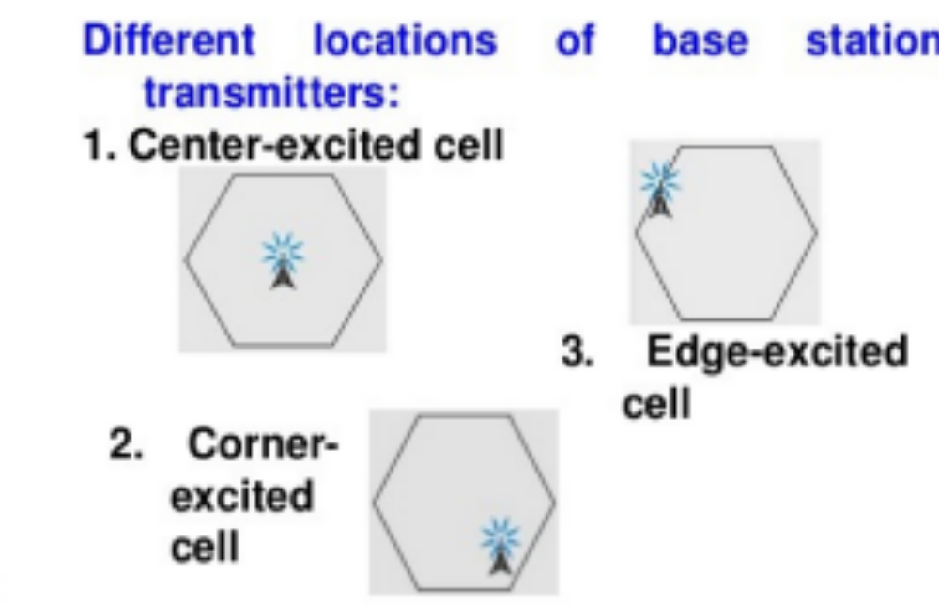
Inside a cell
Center-excited cell
  Tower placed closer to center
    omni-directional antenna
Edge-excited cell
  Towers placed on three of the six corners
    sectored directional antennas.

Slide 5
Channels Reuse
Frequency reuse is the process in which the same set of frequencies (channels) can be allocated to more than one cell, provided the cells are separated by sufficient distance.

Slide 6
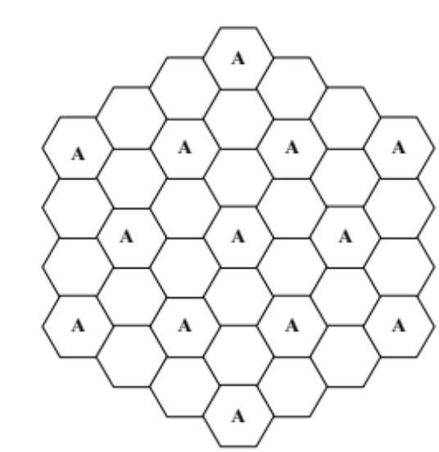
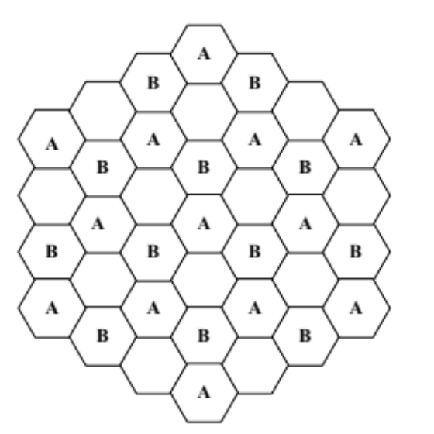
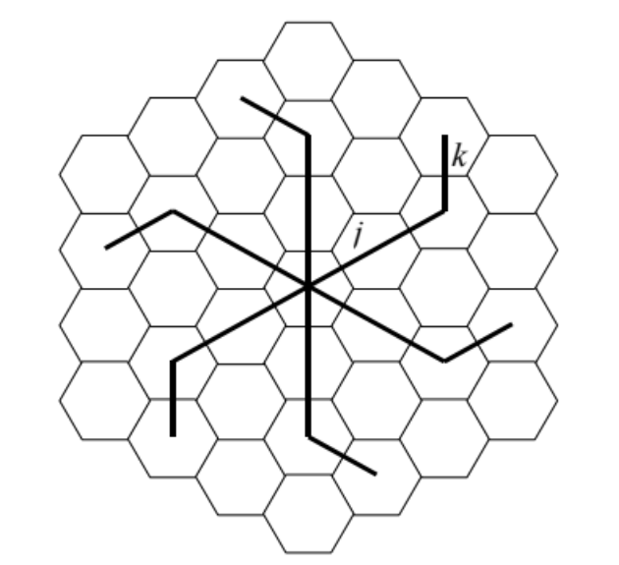
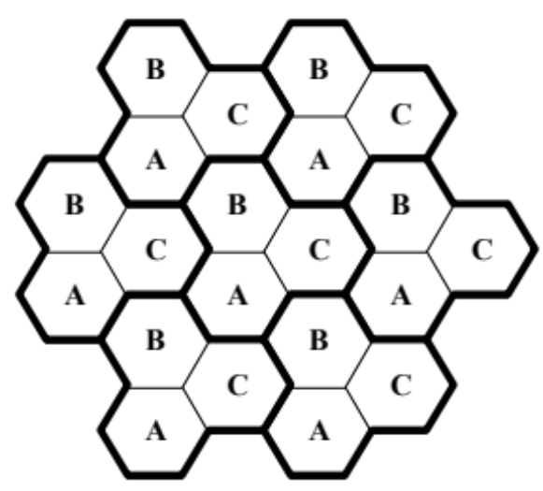
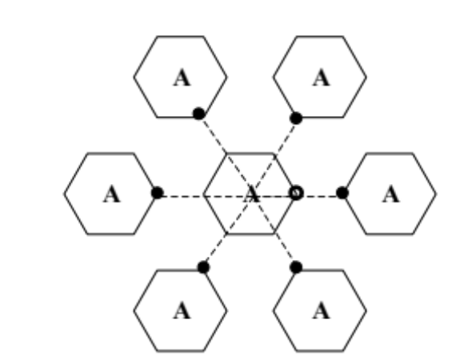
How to create freq reuse?
j=1, k=1
j=2, k=1
3 Clusters, (A,B, C) N=3,
reuse factor f 1/3
Co-Channel Cells

Slide 7
Standard 7 cells sharing system (N = 7)
f₃
f₅
f₂
f₄
f₆
f₅
f₁
f₄
f₃
f₇
f₁
f₂

Slide 8
Other Common Channel Sharing
f₃
f₃
f₃
f₂
f₂
f₁
f₁
f₁
f₃
f₃
3 cell cluster
f₂
f₂
f₂
f₁
f₁
f₃
f₃
f₃
f₂
f₃
f₇
f₅
f₂
f₄
f₆
f₅
7 cell cluster
f₁
f₄
f₃
f₇
f₁
f₂
f₃
f₆
f₅
f₂
f₁
f₂
f₁
f₂
f₁
f₂
f₃
h₁
h₂
f₃
h₁
h₂
f₃
3 cell cluster
with 3 sector antennas
g₁
g₂
h₃
g₁
g₂
h₃
g₁
g₂
g₃
g₃
g₃

Slide 9
F = GN
where F = number of full-duplex cellular channels available in a cluster
G = number of channels in a cell
N = number of cells in a cluster
When a cluster is duplicated m times within a given service area, the total number of full-duplex channels can be expressed mathematically as C = mGN
N=7; G=10;number of clusters =10;
What is F? What is C?
F=10*7=70 channels /cluster
m=10 clusters
C=10*7*10=700 channels total

Slide 10
Interference
Co-channel interference
  Signals from cells that share a channel cause co-channel interference
  Can’t remove it by increasing power.
Adjacent channel interference
  Signals from adjacent cells cause this.
  Use filter to reduce it
But, available channels decrease for incoming calls.

Slide 11
Who and When
Who initiates handoff
  Network directed ( tower determines )
  Terminal assisted ( user helps the tower)
  Terminal directed ( user determines )
When to initiate handoff
  When the mean signal (over some predetermined time) is below some threshold

Slide 12
Types of Handoff
Hard handoff
  Mobile user is passed between disjoint towers that assign different frequency or adapt different air-interface technology
Soft handoff
  Mobile user communicates to two towers simultaneously and the signal is treated as a multipath signal

Slide 13
4G/5G cellular networks
Wireless and Mobile Networks: 7- <number>
similarities to wired Internet
edge/core distinction, but both belong to same carrier
global cellular network: a network of networks
widespread use of protocols we’ve studied: HTTP, DNS, TCP, UDP, IP, NAT, separation of data/control planes, SDN, Ethernet, tunneling
interconnected to wired Internet
differences from wired Internet
different wireless link layer
mobility as a 1st class service
user “identity” (via SIM card)
business model: users subscribe to a cellular provider
  strong notion of “home network” versus roaming on visited nets
  global access, with authentication infrastructure, and inter-carrier settlements

Slide 14

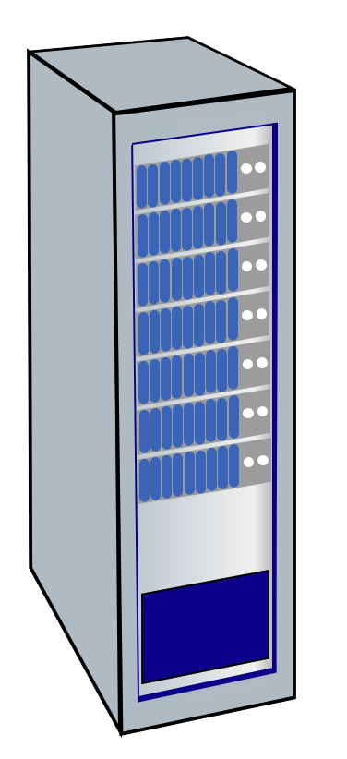




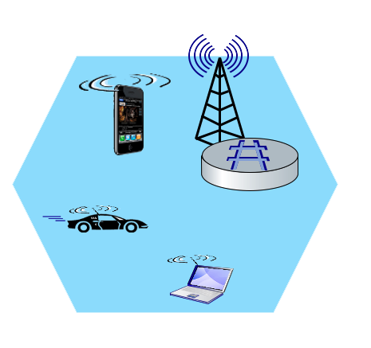
Elements of 4G LTE architecture
Wireless and Mobile Networks: 7- <number>
Mobile device:
smartphone, tablet, laptop, IoT, ... with 4G LTE radio
64-bit International Mobile Subscriber Identity (IMSI), stored on SIM (Subscriber Identity Module) card
LTE jargon: User Equipment (UE)
Mobility Management Entity (MME)
Home Subscriber Service (HSS)
Mobile device
(UE)
Base station
(eNode-B)
to
Internet
PDN gateway (P-GW)
…
Serving Gateway (S-GW)
radio access
network
all-IP Enhanced Packet Core (EPC)

Slide 15
Elements of 4G LTE architecture
Wireless and Mobile Networks: 7- <number>
Base station:
at “edge” of carrier’s network
manages wireless radio resources, mobile devices in its coverage area (“cell”)
coordinates device authentication with other elements
similar to WiFi AP but:
  active role in user mobility
  coordinates with nearly base stations to optimize radio use
LTE jargon: eNode-B
Mobility Management Entity (MME)
Home Subscriber Service (HSS)
Mobile device
(UE)
Base station
(eNode-B)
to
Internet
PDN gateway (P-GW)
…
Serving Gateway (S-GW)

Slide 16
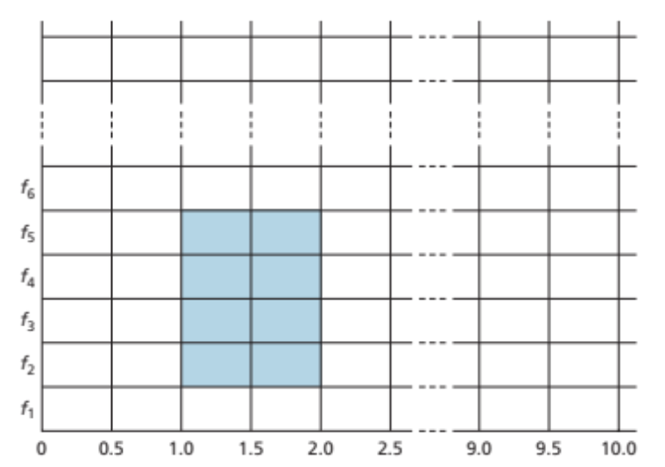
Radio Access Network: 4G radio
Mobile device
(UE)
connects device (UE) to a base station (eNode-B)
  multiple devices connected to each base station
many different possible frequencies bands, multiple channels in each band
  popular bands: 600, 700, 850, 1500, 1700, 1900, 2100, 2600, 3500 MHz
  separate upstream and downstream channels
sharing 4G radio channel among users:
  OFDM: Orthogonal Frequency Division Multiplexing
  combination of FDMA, TDMA
100’s Mbps possible per user/device
Base station
(eNode-B)
Twenty 0.5 ms slots organized into 10 ms frames at each frequency. An eight-slot allocation is shown shaded.
Notes:
G-defined subbands are narrow (e.g., 15 kHz)

